Slide 1

AWS-Powered Image Classification
Final Presentation
Submitted by Rajeswari Tadepalli
November 30, 2024

Slide 2
Outline
Overview of Our Presentation
The project aimed to develop an AWS-powered image classification system for accurate and efficient image recognition.
Key features included image uploading, classification accuracy, a user-friendly interface, and real-time processing.
The development process involved user research, system design, AWS services integration, security measures, testing, deployment, and user training.
A functional demo was provided, with development completed, including the integration of image upload and result generation functionality.
The overall project impact included enhanced image recognition capabilities, improved user experience, and potential applications in various industries.

Slide 3
Background
Understanding the Project Background
The project leveraged AWS technology to enhance image classification capabilities.
It improved accuracy and efficiency in identifying and categorizing images.
The project bridged gaps in machine learning applications, advancing image processing.
By focusing on robust algorithms, the project empowered users to make data-driven decisions.
The project also recognized the significance of effective image classification in various industries, including healthcare and retail.

Slide 4
Budget Summary
The original budget for the project was $49,175, covering personnel costs for various roles including project management, software development, UI/UX design, quality assurance, business analysis, training, and documentation.
There were no major changes to the budget, and all expenses remained within the original plan.
The final budget stayed at $49,175, with all categories on track.
Effective resource management ensured that no additional funding was required.
The project was completed on budget with no unexpected costs.
Proactive financial oversight helped in keeping costs in check throughout the project's duration.

Slide 5
Development
Development Process Overview
Extensive research was conducted to identify key features of the system.
Design work resulted in user interface prototypes to enhance usability.
The user interface development was completed.
Core functionality was fully developed, including:
Integration of image upload and result generation logic.
Implementation of user account logic.
Establishment of security measures, such as data encryption and user authentication.
Rigorous testing phases were conducted to ensure functionality, security, and a seamless user experience.

Slide 6
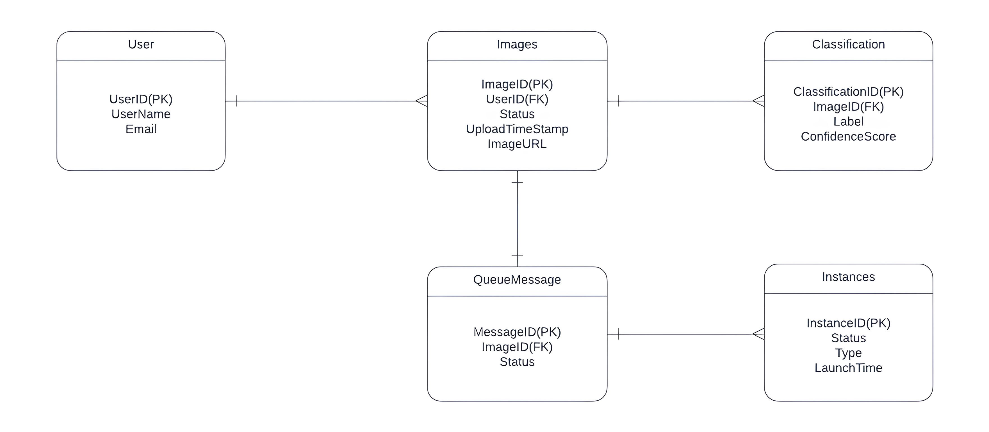
E-R Diagram in Third Normal Form for efficient data storage and retrieval.
Created using Lucidchart for accuracy and adherence to standards.
User, Image, Classification, Instance, and QueueMessage tables represent the core entities of the system.
Entities facilitate structured image classification, linking images to users, classifications, and processing tasks.
Ensures data normalization and integrity, preventing redundancy and inconsistency in the database.
E-R Diagram

Slide 7
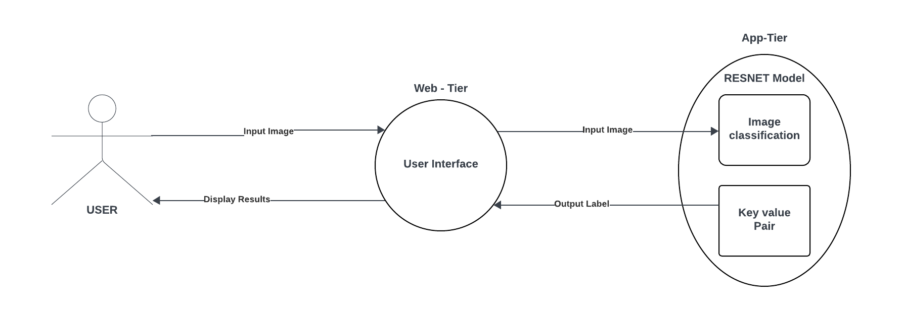
Level 0 DFD
Level 0 DFD Explanation:
Represents the overall image classification system and its interactions with external entities.
Shows the primary data flows between users, the system, and external services.
Identifies key processes such as image upload, classification, and result retrieval.
Highlights external entities including users, clients, and system administrators.
Provides a high-level overview without delving into specific system components or processes.

Slide 8
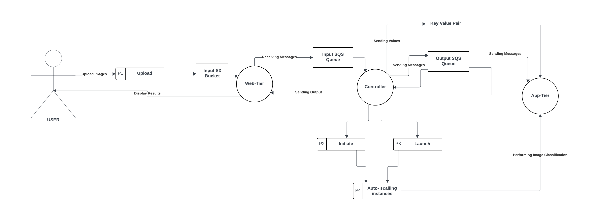
Level 1 DFD
Level 1 DFD Explanation:
Breaks down primary processes into detailed subprocesses.
Illustrates user interactions for image upload, progress monitoring, and result retrieval.
Depicts internal processes for image pre-processing, classification, and logging.
Shows interactions with AWS for storage and classification.
Identifies data stores and flow paths for better process understanding.

Slide 9
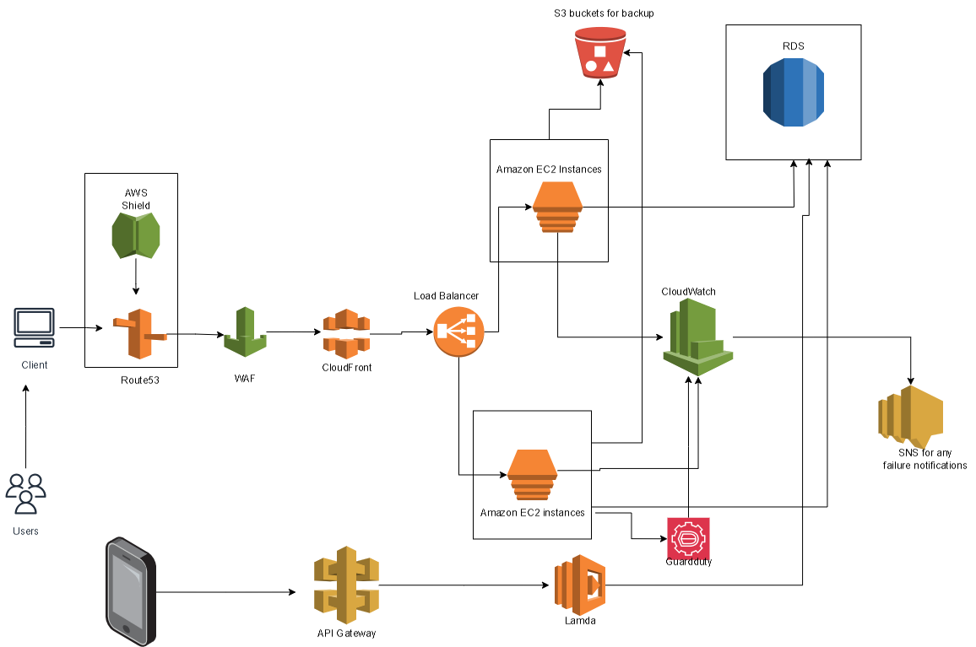
Network Diagram
Network Diagram Components:
Users upload photos via web, mobile clients.
AWS Route 53 directs user traffic efficiently.
Web Application Firewall (WAF) prevents attacks.
Amazon API Gateway facilitates image uploads seamlessly.
AWS Lambda triggers image categorization processes.
Images stored securely in Amazon S3.

Slide 10
Frontend and backend development
Key components and technologies:
The system featured a user-friendly interface for image uploads and viewing classification results.
Technologies such as HTML, CSS, and JavaScript were used for the frontend, while Flask supported backend development.
AWS S3 was integrated for storage, AWS Lambda for serverless operations, and AWS SageMaker for model building and training.
The design emphasized responsive UX/UI principles for optimal usability and scalability.

Slide 11
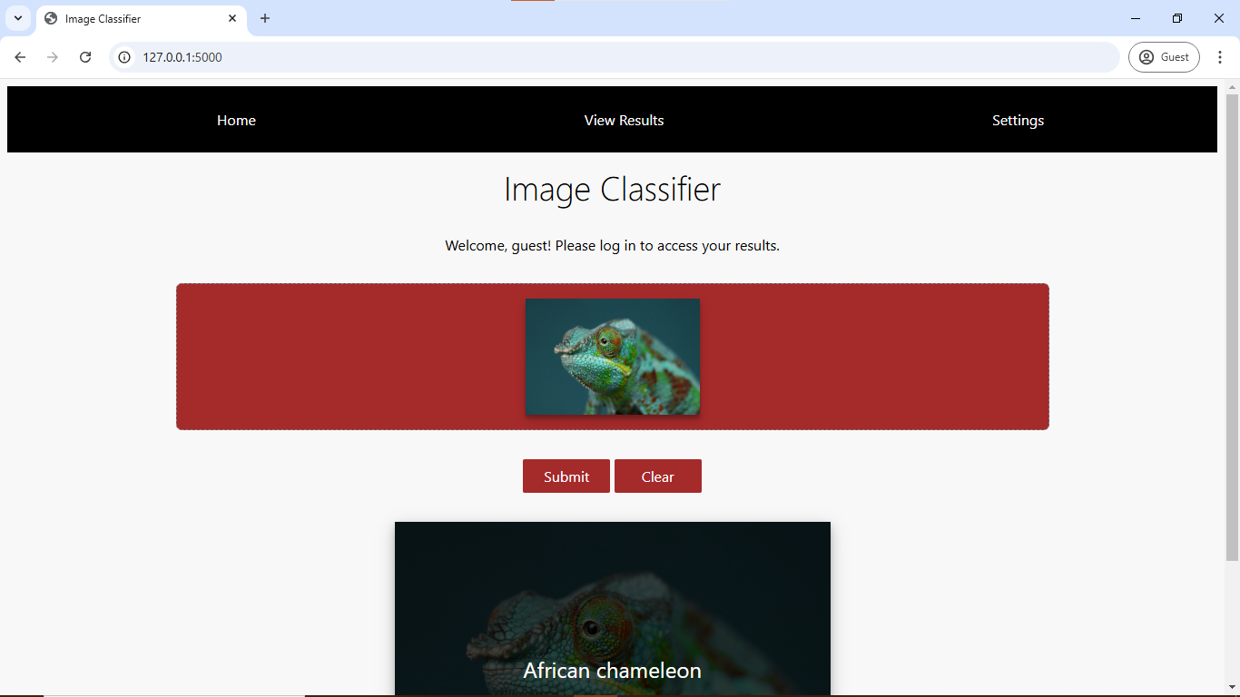
Sample Front-End Component
Sample screenshot of the home page
Navigation items for:
Home
View Results
Settings

Slide 12
Security Measures
To ensure the security of the system, the following measures were implemented:
A Web Application Firewall (WAF) was deployed for online threat protection.
IAM (Identity and Access Management) was used for access control.
Multi-factor authentication (MFA) was employed for enhanced security.
Data was encrypted both in transit and at rest.
IAM was configured for least-privilege access, with database auditing enabled.
Strong password policy and role based user access

Slide 13
Results…
Project Results and Achievements
The project completed the user interface design and core functionality, including image upload integration and result generation.
The user account management system was fully implemented, with robust security measures in place.
Security features such as data encryption and user authentication were thoroughly tested and integrated.
The development process involved rigorous testing to ensure optimal functionality, security, and user experience.

Slide 14
Lessons Learned
Conducting thorough user research early on helped identify critical features that aligned with user needs, ensuring the project’s success.
Emphasizing a simple and intuitive interface made the application more accessible, improving user experience throughout the project.
Leveraging AWS services like S3, Lambda, and SageMaker allowed the system to scale effectively and handle high volumes of image data seamlessly.
Implementing security measures like data encryption and user authentication early ensured user data protection and helped mitigate potential risks.
Scheduling regular testing phases throughout development allowed us to identify and resolve issues promptly, improving functionality and security.
Adapting to changes in project requirements and feedback from testing phases ensured smooth project progress and quality maintenance.

Slide 15
Conclusion
The AWS-Powered Image Classification project successfully developed a functional image classification solution.
All planned features, including image upload capabilities, result generation, and user account management, were implemented.
Security measures such as data encryption and user authentication were fully integrated, ensuring data protection.
Rigorous testing phases confirmed the reliability and performance of the system.
The project delivered a robust and user-friendly image classification solution, meeting all objectives.

Slide 16
Thank you

